Slide 1




OO02: SQL Injection Attack Detection & Prevention
Progress Update – First Meeting
GitLab Link: https://gitlab2.eeecs.qub.ac.uk/40228223/sql-injection-attack-detection-and-prevention

Slide 2
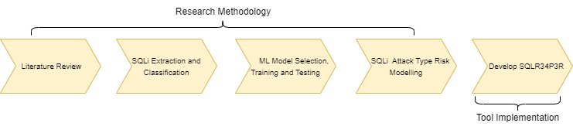
Project Flow
Literature Review: Find limitations in state-of-the-art SQL injection detection and prevention solutions.
SQLi Payload Extraction and Classification: Classify SQLi payloads into different attack classifications, auth bypass, Command Execution, DDoS, Blind, Bypass Techniques.
ML Model Selection, Training and Testing: Train the model using Multiclass classifier on the different attack type classifications.
SQLi Attack Type Risk Modelling: Perform risk modelling on the different attack type classifications using several metrics.
Develop SQLR34P3R

Slide 3
Literature Review – Some State-Of-The-Art Limitations
Solution | Advantages | Limitations/Potential Improvements
SQL-IDS | Logging Capabilities High Accuracy & Performance | Restricted to Java Apps Unable to detect new SQLi techniques
AMNESIA | Low FPR and Performance Overhead High Accuracy | Unable to detect Stored Procedures SQLi Restricted to Java Apps
SQLIADP | Easy deployment and fast response times. Zero false reduction | Does not specify what SQLi types are detected.
Neuro—Fuzzy SQLi Detection | High accuracy (98.4% accuracy with the duration being 217 s for 13,079 attacks) | Limited set of training data. Does not specify what SQLi types are detected.
SVM Machine Learning Predictive Analytics | Detects new SQLi techniques | Does not specify what SQLi attack types are detected. Binary Classifier

Slide 4

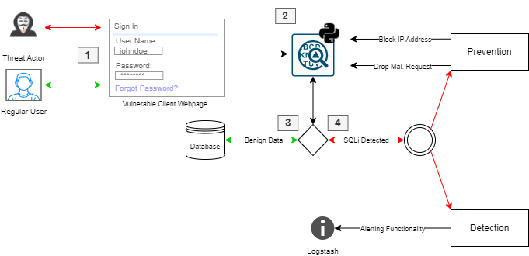
System Flow Architecture
1.
Threat actor – malicious SQLi input
Normal User – Benign Input
Proxy command line tool that intercepts and predicts SQLi input. Performs categorization and risk modelling.
If benign data is detected, intended response is displayed back to the user.
SQLi Attack: Request is dropped, and IP is blocked. Alert is logged to logstash for flexible SIEM integration.

Slide 5
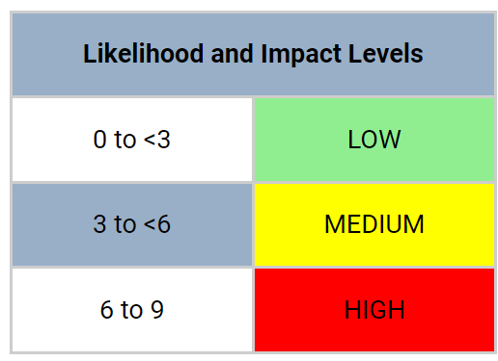
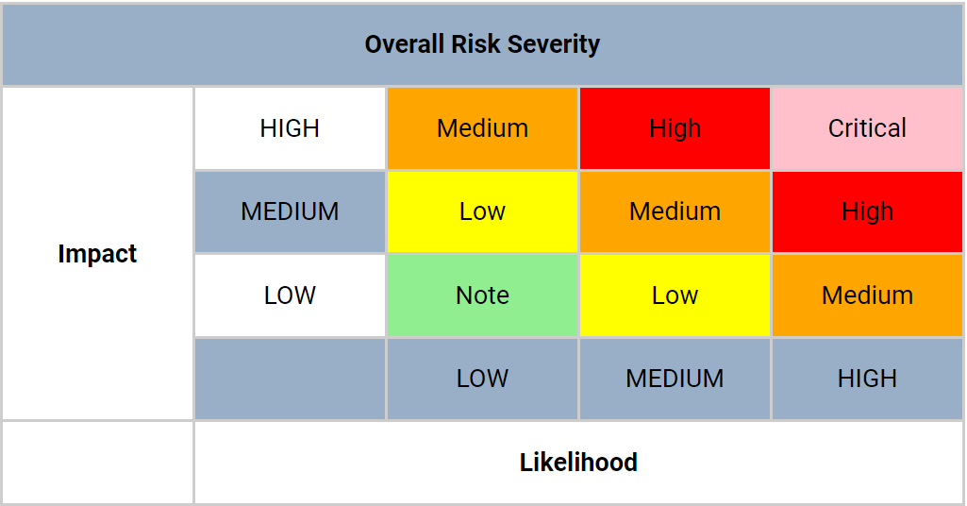
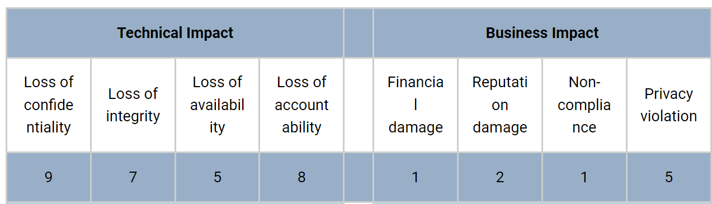
OWASP RRM: Risk Modelling
Risk = Likelihood * Impact
Likelihood = AVG(Threat Agent Factors + Vulnerability Factors)
Impact = AVG(Technical Impact + Business Impact)
Threat agent Factors:
Skill level, Motive, Opportunity and Size
Vulnerability Factors:
Ease of Discovery, Ease of Exploit, Awareness, Intrusion Detection
Impact Factors:

Slide 6

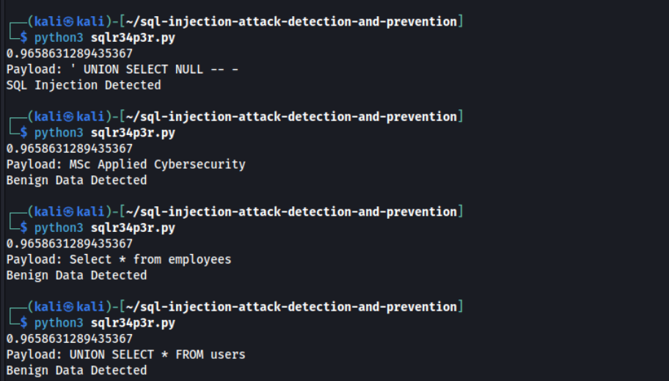

Implementation So Far

Slide 7
Next Steps
Test and Evaluate Other Classifiers (Random Forests, Naive Bayes classifier)
Categorise attacks to SQLi Attack Types (Command Execution, DoS, Blind, Bypass Techniques)
Implement Continuous Testing through Gitlab CI/CD Pipelines
Continue Literature Review

